Slide 1





2025 IEEE iSSSC
2025 IEEE 3rd International Symposium on Sustainable Energy, Signal Processing & CyberSecurity
Paper Title:FusionNet-Vision: Glaucoma Detection Using Feature-Aware Segmentation and Transparent Classification Layers
Paper ID:
Presenter Name:
Authors: Chalicheema Rajani, Bhavana Valluri, Bhargavi Ravi, Deepthi Galla, Sireesha Moturi
Affiliation:Narasaraopeta Engineering College

Slide 2
Outline
Introduction (try to answer what it is, why it is, and what is (are) existing problems, why the problem is so important to discuss; may cite in the footer)
Motivation & Contributions
Proposed System Model
Results and Discussion
Conclusion
Reference

Slide 3
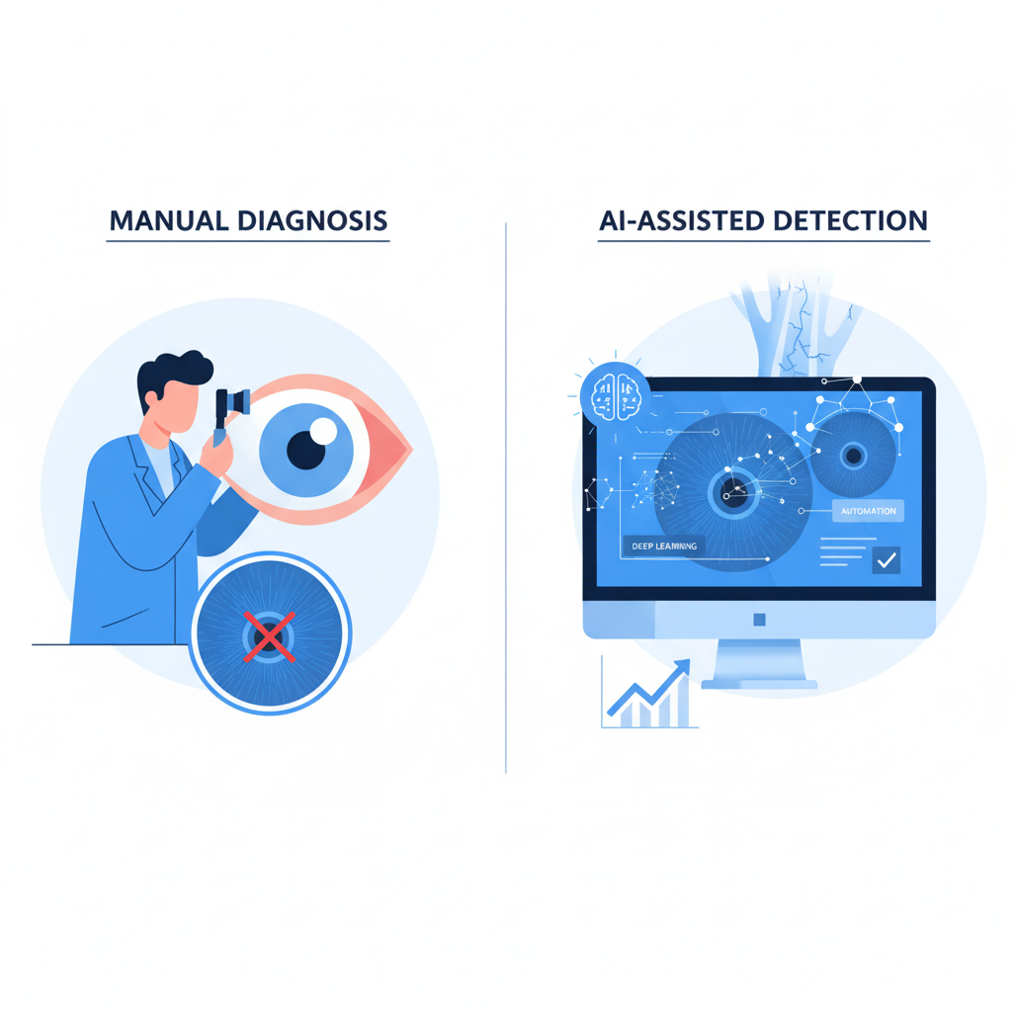
Introduction
Glaucoma is one of the leading causes of permanent blindness worldwide.
It damages the optic nerve gradually, often without symptoms (“silent disease”).
Manual diagnosis using retinal fundus images is time-consuming and subjective.
Deep learning can automate this process and improve early detection accuracy.
The aim is to design a reliable, explainable, and accurate system for glaucoma screening.

Slide 4
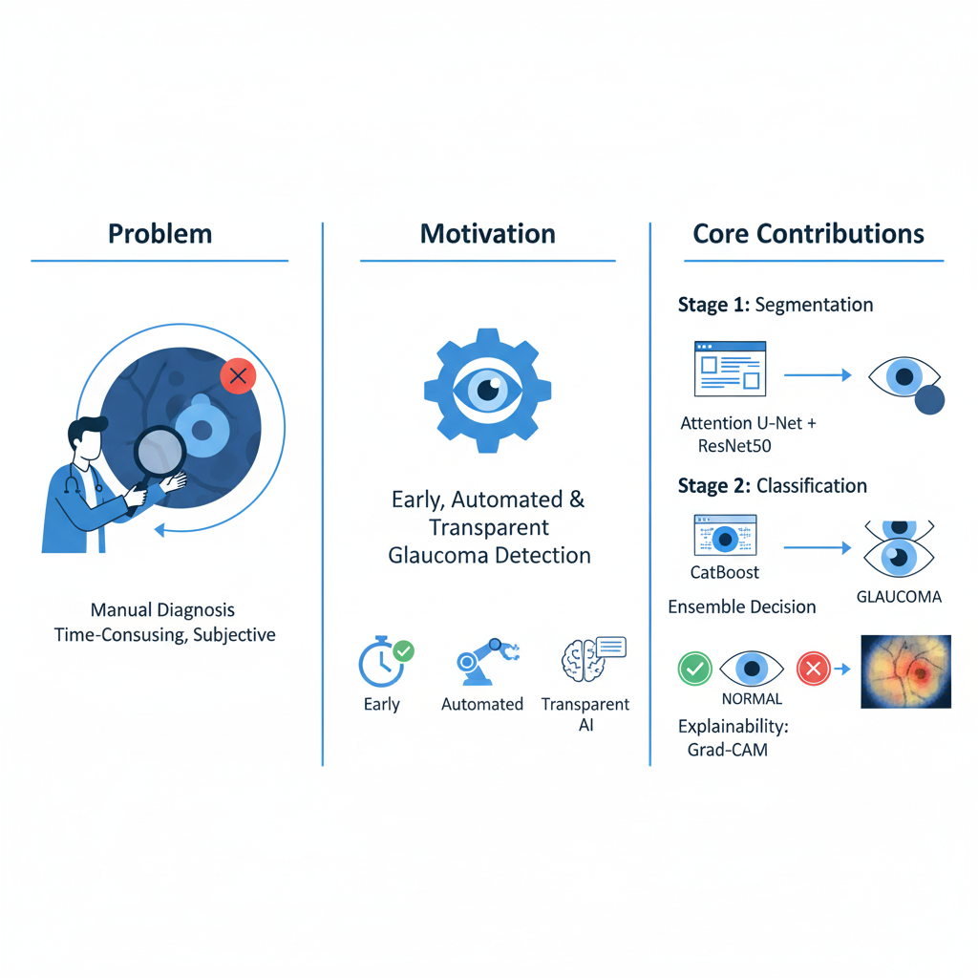
Motivation & Core Contribution
Problem: Manual diagnosis lacks consistency and scalability.
Motivation: Early, automated, and transparent glaucoma detection helps in prevention.
Core Contributions:
Two-stage framework combining segmentation and classification.
Attention U-Net (with ResNet50) for optic disc/cup segmentation.
InceptionV3 + CatBoost ensemble for final glaucoma classification.
Grad-CAM and Grad-CAM++ for explainable visual reasoning.

Slide 5
Literature Review
Many researchers have worked on automated glaucoma detection using deep learning methods like CNNs.
Zedan et al. (2023) gave a detailed review showing that CNNs perform well but often fail to explain their predictions clearly.
Selvaraju et al. (2017) introduced Grad-CAM, which helps visualize where a model is focusing in an image.
Chattopadhay et al. (2018) improved it with Grad-CAM++, giving clearer attention maps for medical images.
Pascal et al. (2022) designed a multi-task CNN that segments the optic disc and also classifies glaucoma with high accuracy.
Sreng et al. (2020) used DeepLabv3+ to detect optic disc and cup areas and reached over 95% accuracy.
Velpula and Sharma (2023) combined several pre-trained CNN models like DenseNet and VGG19 in an ensemble, improving results for early detection.
Kashyap and Srivastava (2022) created an improved U-Net for retinal image segmentation.
Kalaiselvi et al. (2023) used GANs to enhance fundus images for better glaucoma detection.

Slide 6
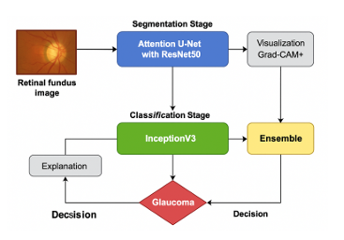
Proposed System Model
Stage 1: Attention U-Net with ResNet50 encoder segments optic disc and cup.
Stage 2: InceptionV3 classifier + CatBoost ensemble predicts glaucoma presence.
Explainability: Grad-CAM visualizations show the model’s focus areas.
Outcome: Accurate and interpretable glaucoma diagnosis.

Slide 7
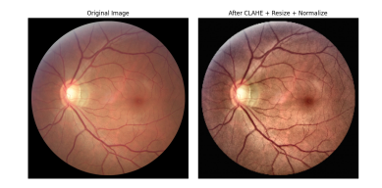
Dataset & Preprocessing
Dataset: REFUGE (Retinal Fundus Glaucoma Challenge) – 1,200 labeled fundus images
400 train / 400 validation / 400 test
Images captured using different cameras for
better generalization
Preprocessing Steps:
Resizing to 224×224
Contrast enhancement using CLAHE
Normalization and data augmentation
Histogram equalization for clearer disc boundaries

Slide 8
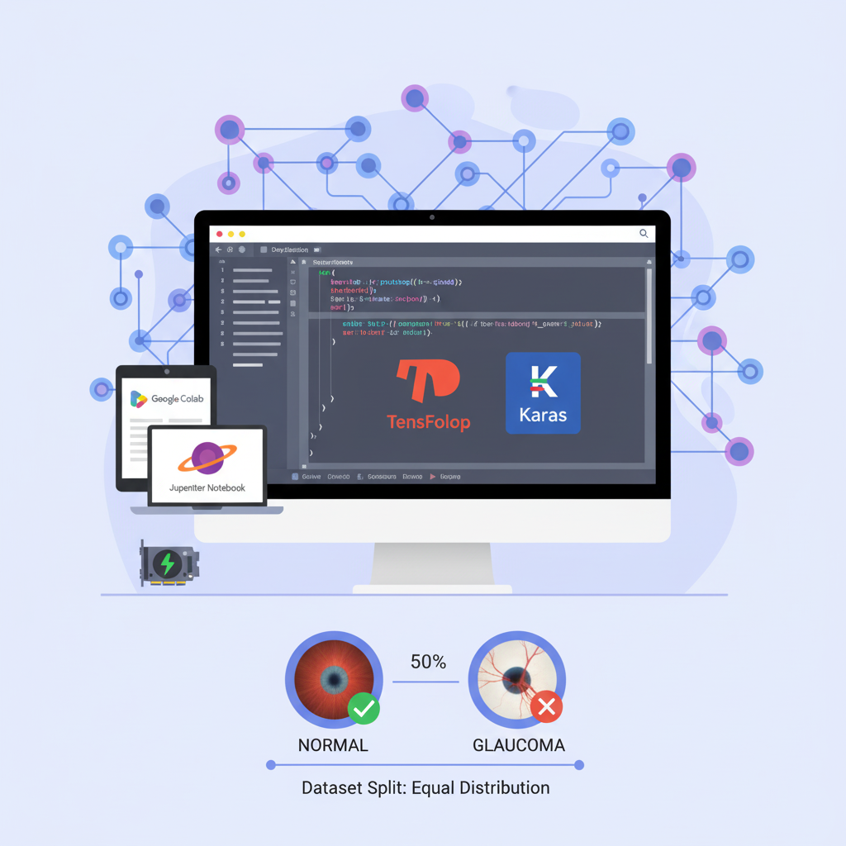
Simulation Setup
Hardware:
Intel i7 (12th Gen),
16 GB RAM,
RTX 3060 (12 GB)
Software:
Python,
TensorFlow,
Keras, CUDA 11.2
Environment:
Google Colab / Jupyter Notebook
Dataset split ensures equal distribution of normal and glaucomatous images.

Slide 9
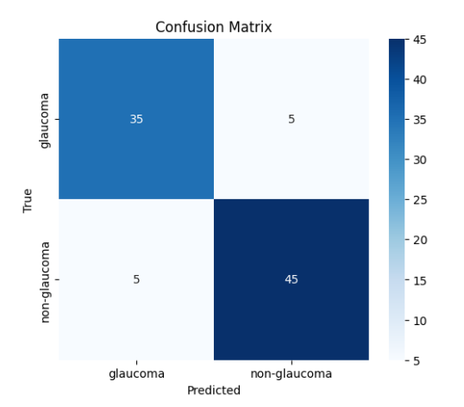
Result and Discussion
Segmentation:
IoU ≈ 0.88, Dice Score ≈ 0.91
Classification:
Accuracy: 94%
AUC: 0.97
F1-Score: 0.93
Sensitivity: 92%, Specificity: 94%
Comparison:
Outperformed Logistic Regression (78%),
SVM (84%),
plain CNN (89%).

Slide 10
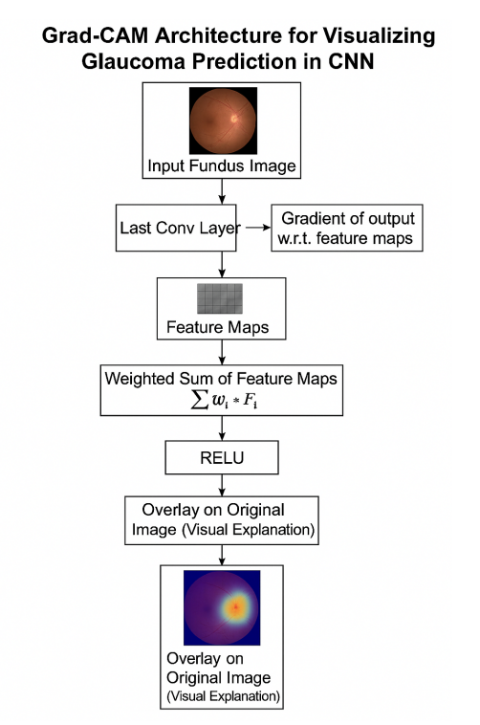
Explainability (Grad-CAM)
Grad-CAM and Grad-CAM++ highlight regions that influenced
the model’s decisions.
Helps clinicians trust and interpret model outputs.
Enhances transparency of deep learning predictions.

Slide 11
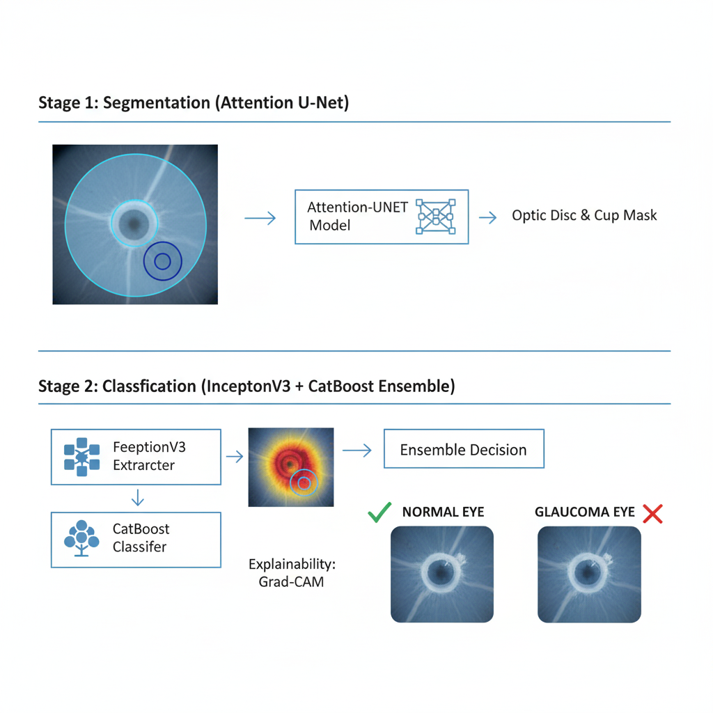
Conclusion & Future Work
A hybrid deep learning model was developed for early glaucoma detection.
Combines segmentation (Attention U-Net) and classification (InceptionV3 + CatBoost).
Achieves high accuracy and interpretability.
Supports ophthalmologists with automated, explainable decision tools.
Extend to multi-disease eye detection (diabetic retinopathy, cataract).
Include larger, multi-center datasets for better generalization.
Optimize the system for mobile or edge devices to enable real-time screening.

Slide 12

References
Selvaraju et al., “Grad-CAM: Visual Explanations from Deep Networks,” ICCV 2017.
Zedan et al., “Deep Learning for Glaucoma Diagnosis,” Diagnostics, 2023.
Velpula & Sharma, “Pre-trained CNN Fusion Strategy,” Front. Physiol., 2023.
Pascal et al., “Multi-task CNN Model for Glaucoma Detection,” Sci. Rep., 2022.
R. Hemelings, “Developing a generalizable deep learning model for glaucoma screening,” NPJ Digital Medicine, vol. 6, no. 1, p. 45, 2023.
M. J. Zedan, M. M. Ahmad, and A. M. Abdel-Hamid, “A comprehensive survey on explainable AI techniques for medical image analysis,” Diagnostics, vol. 14, no. 2, p. 310, 2024.

Slide 13
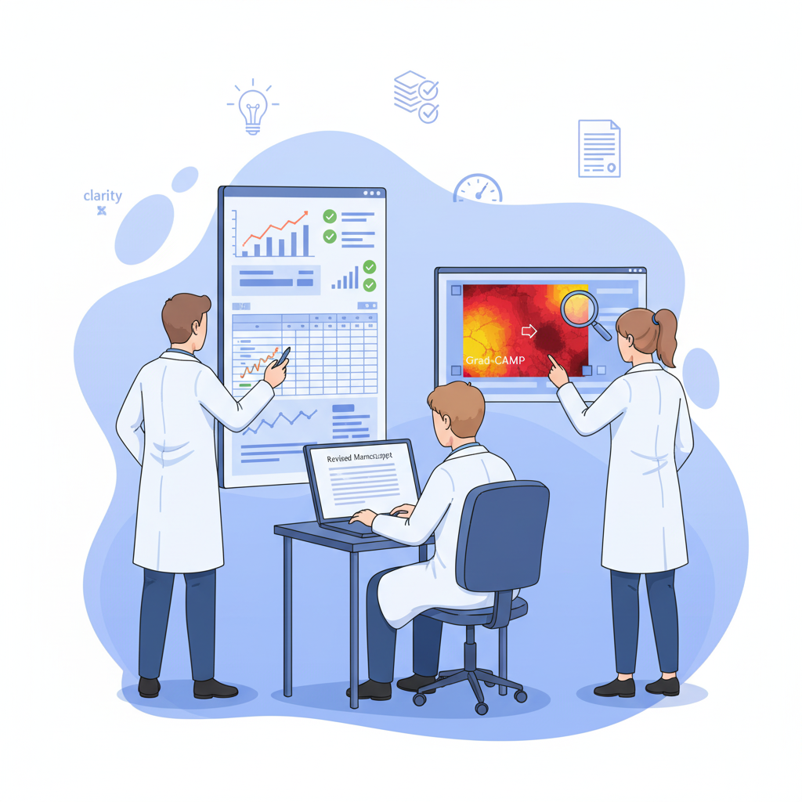
Reviewer Comments Addressed
Improved clarity in methodology and dataset description.
Enhanced evaluation with additional metrics and comparison table.
Added Grad-CAM explainability for transparency in predictions.

Slide 14
Thank You

